Slide 1

Designing a 16-Bit RISC-V Processor with 8 Commands Using Vivado
Notes:
This presentation outlines the steps involved in designing a 16-bit processor with 8 commands using the Vivado Design Suite. We will cover the objectives of the project, the architecture of the processor, command implementation, simulation, and verification, and finally, the implementation on the PYNQ-Z2 board.

Slide 2
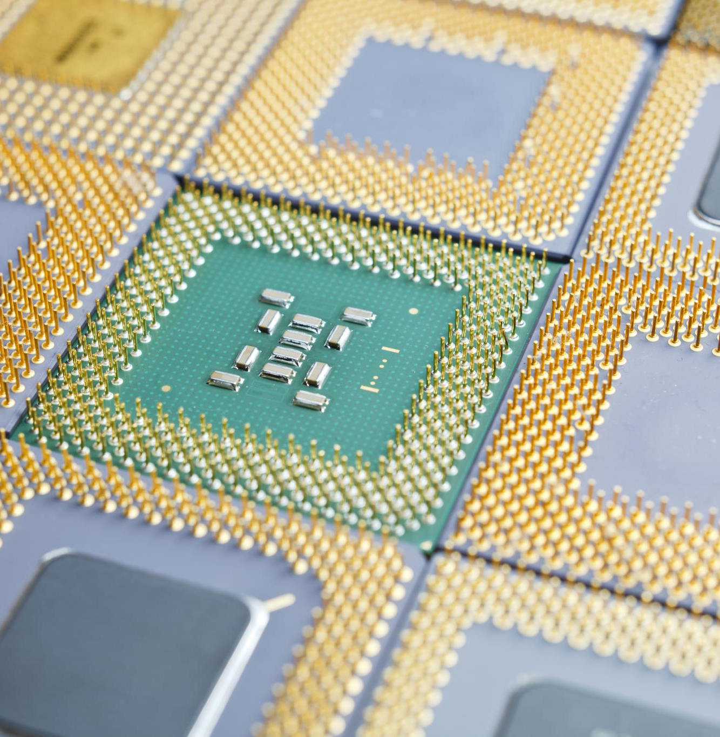
Agenda for Today's Presentation
Introduction to the Project
Processor Architecture and Command Set
Command Implementation
Simulation and Verification
Implementation on PYNQ-Z2 Board
Conclusion and Future Work
Notes:
In this presentation, we will introduce the project objectives and provide an overview of the Vivado Design Suite and the PYNQ-Z2 board. We will then dive into the processor architecture and its command set before discussing the implementation of each command, simulation and verification, and conclude with insights on future work.

Slide 3
Introduction to the Project
Notes:
This section introduces the project, outlining its key objectives and goals. Understanding the design environment is crucial to successfully developing the processor.

Slide 4

Project Objectives and Goals
Design a 16-bit Processor
The project aims to design a functional 16-bit processor capable of executing eight specific commands, enhancing computational capabilities.
Understanding Digital Design
We aim to deepen our understanding of digital design principles, which are crucial for successful hardware implementation.
Notes:
The primary objective of this project is to design a functional 16-bit processor that can execute 8 specific commands. Additionally, we aim to enhance our understanding of digital design principles and FPGA implementation.

Slide 5
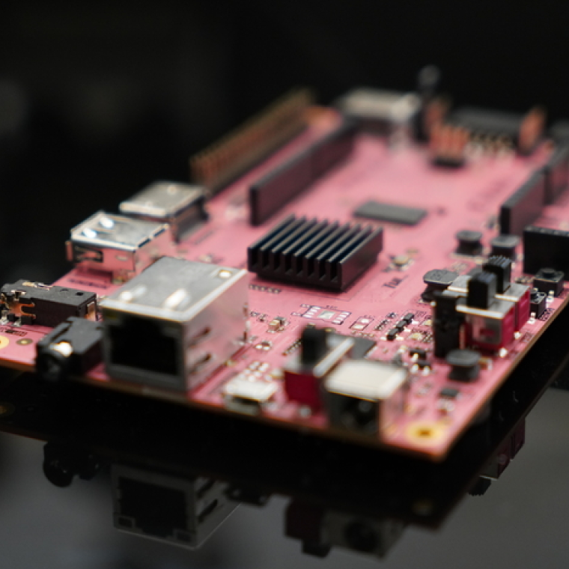
Introduction to the PYNQ-Z2 Board
FPGA Development Board
The PYNQ-Z2 board serves as an FPGA development platform, enabling advanced hardware designs and digital signal processing projects.
Xilinx Zynq-7000 SoC
This board is based on the Xilinx Zynq-7000 System on Chip, integrating programmable logic with an ARM processor for versatile applications.
Custom Processor Design
The combination of programmable logic and ARM processing capabilities allows for custom processor designs tailored to specific applications.
Notes:
The PYNQ-Z2 board is an FPGA development board based on the Xilinx Zynq-7000 SoC. Its combination of a programmable logic and an ARM processor makes it suitable for implementing our custom processor design.

Slide 6
Processor Architecture and Command Set
Notes:
In this section, we will explore the architecture of the 16-bit processor and discuss the command set it supports, which is essential for understanding how the processor operates.

Slide 7
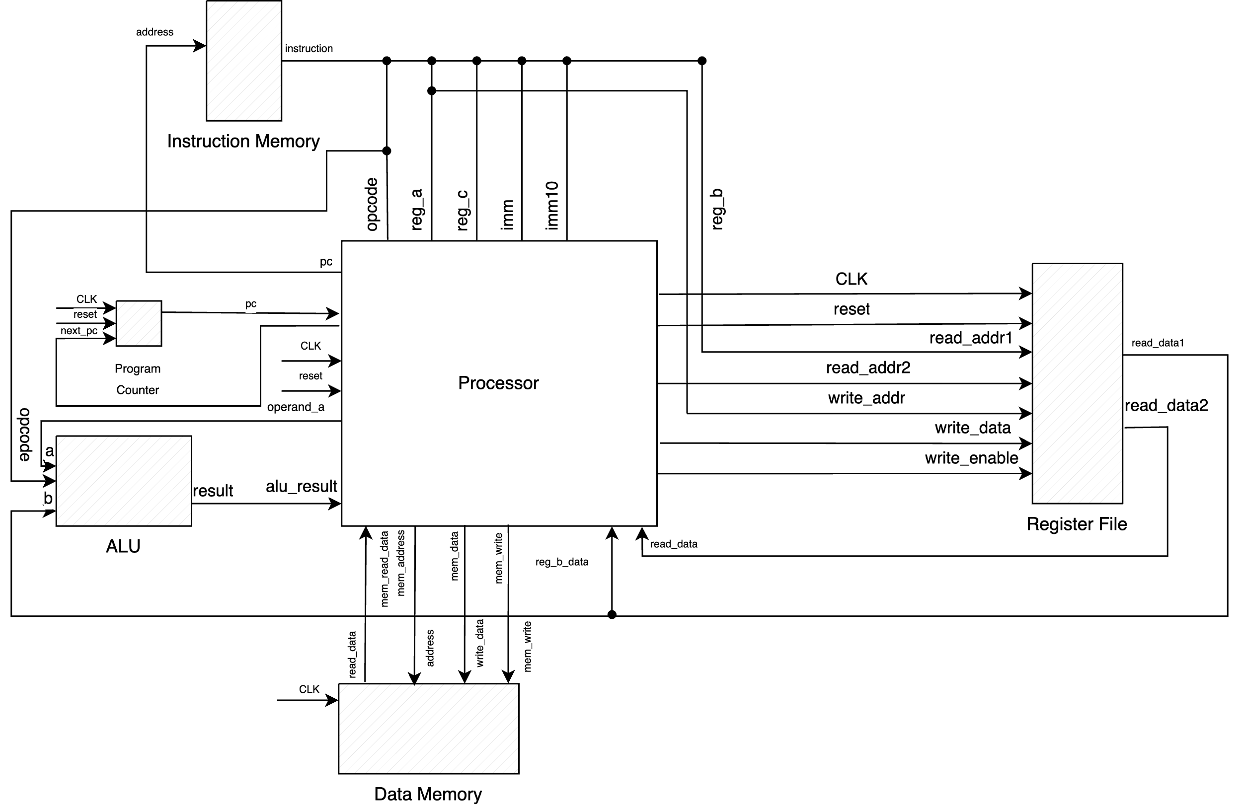
Overview of the 16-Bit Processor Architecture
Register File
Stores temporary data and instructions for quick processor access.
Arithmetic Logic Unit (ALU)
Performs arithmetic and logical operations for instruction execution.
Processor
Directs data flow and manages instruction execution.
Data Memory
Stores and retrieves data needed during execution.
Instruction Memory
Holds program instructions for the processor to execute.
Notes:
The 16-bit processor architecture includes a register file, an arithmetic logic unit (ALU), and processor, all designed to work together to execute instructions efficiently.

Slide 9
Command Implementation
Notes:
This section details the implementation of each command supported by the processor, focusing on their functionality and how they are coded in the assembly language.

Slide 10
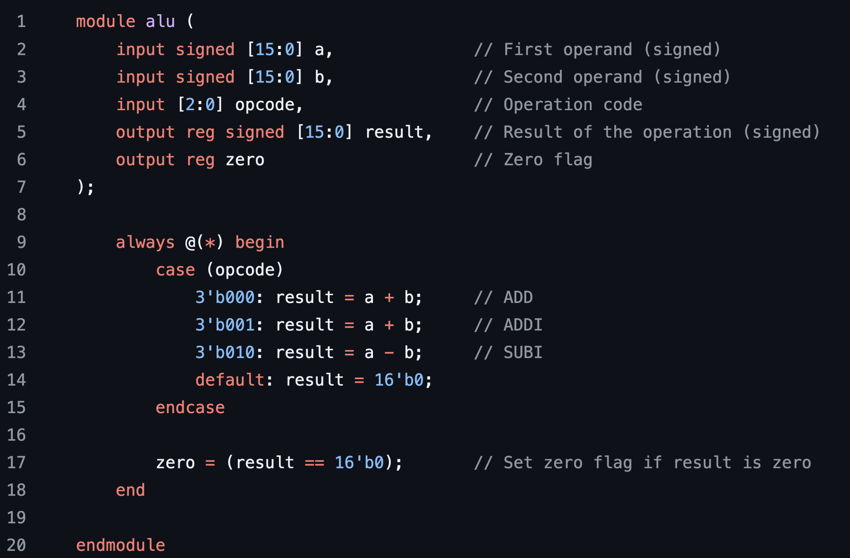
ADD/ADDI/SUBI commands
Purpose of Commands
ADD: reg_a + reg_b = result
ADDI: reg_a + imm = result
SUBI: reg_a – imm = result
Signed Integer Values
Understanding signed integers is crucial, as they can represent both positive and negative values in calculations.
Notes:
The ADD command performs addition on two signed integer values, contained in two registers. The SUBI and ADDI are operations that add/subtract value from the register and a value contained in the instruction.
All of the operands are signed, so they include both positive and negative numbers.

Slide 11
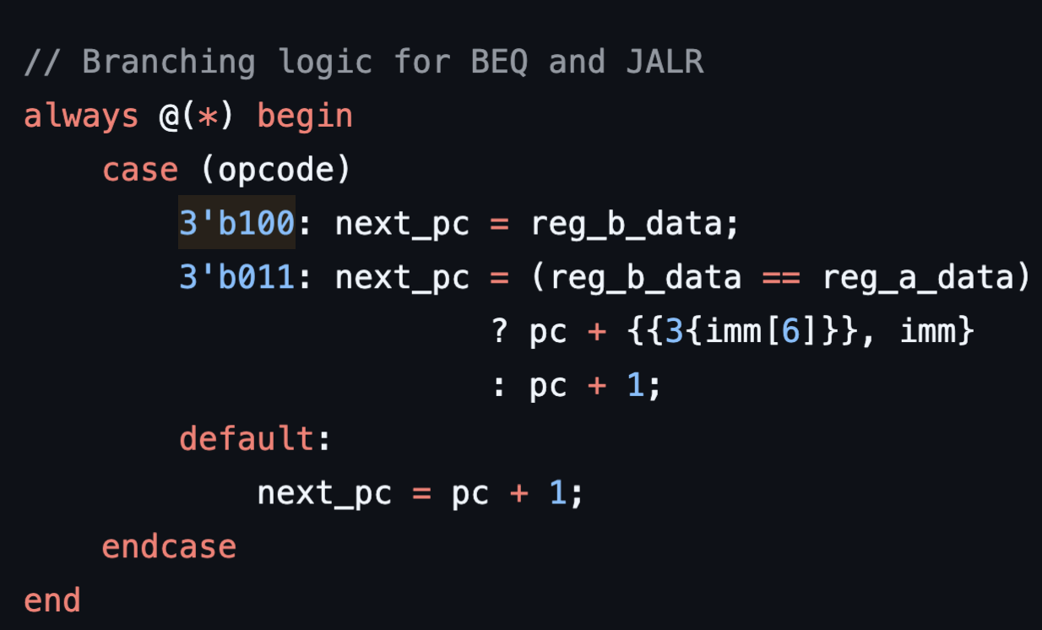
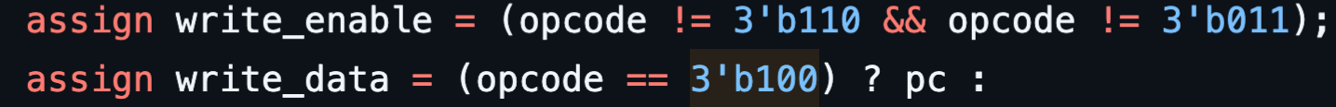
BEQ: Branch if Equal
Conditional Branching (BEQ)
Compare reg_a to reg_b
If they are the same: next_pc = pc + imm
If they are different: next_pc = pc + 1
Jump and Link Register(JARL)
Store pc in reg_a
next_pc = reg_b
Notes:
The BEQ command allows

Slide 12
LUI: Load Upper Immediate
Register Manipulation
LUI is a command used to manipulate computer registers by setting upper bits to facilitate calculations.
Handling Immediate Values
This command is crucial for managing larger immediate values which are essential in various computational tasks.
Applications in Calculations
The LUI command enhances the ability to work with larger numbers in calculations, improving performance in programming.
Notes:
The LUI command sets the upper 16 bits of a register, which is useful for handling larger immediate values in calculations.

Slide 13

SW: Store Word (Half)
Data Storage Mechanism
The SW instruction facilitates the storage of a word from a register into memory, ensuring data is preserved.
Memory Manipulation
By using the SW instruction, programs can manipulate stored data efficiently in memory for various applications.
Notes:
SW is used to store a word from a register into memory, allowing for data preservation and manipulation in programs.

Slide 14

LW: Load Word (Half)
Data Loading Process
The LW command is vital for moving data from memory to a register, enabling effective computations.
Importance of LW Command
Loading values into registers is crucial for the performance of computations in computing systems.
Notes:
The LW command loads data from memory into a register, essential for retrieving values needed for computations.

Slide 15
Simulation and Verification
Notes:
In this section, we will discuss how to set up a simulation environment in Vivado, create testbenches for each command, and analyze the simulation results to ensure correctness.

Slide 16

Setting up the Simulation Environment in Vivado
Configuring Settings
Accurate simulation requires configuring specific settings in Vivado to reflect the processor's behavior during testing.
Simulation Accuracy
Properly setting up the simulation environment is crucial for achieving reliable and accurate results in processor behavior simulation.
Notes:
Setting up the simulation environment involves configuring settings within Vivado to accurately simulate the behavior of the designed processor.

Slide 17

Creating Testbenches for Each Command
Importance of Testbenches
Testbenches are essential for ensuring that each command implementation functions correctly and meets design specifications.
Simulation of Scenarios
Creating testbenches allows us to simulate various scenarios, providing comprehensive testing for each command implementation.
Thorough Testing Process
A thorough testing process using testbenches ensures that all edge cases and functionalities are verified before deployment.
Notes:
Testbenches are crucial for verifying the functionality of each command implementation. We will create testbenches that simulate different scenarios for thorough testing.

Slide 18

Analyzing Simulation Results and Debugging
Analyzing Simulation Results
We examine simulation results to identify discrepancies, ensuring accuracy in the design process.
Identifying Bugs
The analysis helps in spotting bugs that need to be addressed for the final design to function properly.
Iterative Debugging Process
Debugging is an iterative process that refines the design and ensures it meets all specifications.
Notes:
After running simulations, we analyze the results to identify any discrepancies or bugs. Debugging is an iterative process that ensures the design meets the specifications.

Slide 19
Implementation on PYNQ-Z2 Board
Notes:
This section focuses on the steps to implement the designed processor on the PYNQ-Z2 board, ensuring that the design is functional in a real-world environment.

Slide 20
Configuring the PYNQ-Z2 Board for the Project
Hardware Connections
Setting up the necessary hardware connections is critical for the proper functioning of the PYNQ-Z2 board.
Software Installation
Installing the required software is essential to support the project's functionalities and features on the PYNQ-Z2 board.
Notes:
Configuring the PYNQ-Z2 board involves setting up the necessary hardware connections and installing any required software to support the project.

Slide 21

Transferring the Design to the Board
Design Preparation
The design must be fully prepared and compiled before transferring files to the PYNQ-Z2 board.
Transfer Process
Transferring the programming files involves using appropriate software tools to ensure accuracy and efficiency.
Implementation on Board
Once transferred, the design is implemented on the PYNQ-Z2 board to test functionalities and performance.
Notes:
Once the design is ready, we transfer the compiled programming files from Vivado to the PYNQ-Z2 board for implementation.

Slide 22

Testing and Validating the Processor on Hardware
Processor Testing
Testing the processor on the PYNQ-Z2 board is essential to ensure its functionality and performance.
Hardware Validation
Validation confirms that the processor design operates correctly in a real hardware environment, preventing potential issues.
Notes:
Finally, we test the processor on the PYNQ-Z2 board to ensure that it operates as expected. Validation is critical to confirm that the design functions correctly in hardware.

Slide 23
Conclusion and Future Work
Notes:
In this concluding section, we will summarize the achievements of the project, the challenges faced, and the potential for future improvements.

Slide 24

Summary of the Project Achievements
16-bit Processor Design
The project involved designing a 16-bit processor that can perform various tasks efficiently.
Command Execution Capability
The processor was designed to execute 8 different commands, showcasing its versatility and functionality.
Vivado Design Suite
Utilized the Vivado Design Suite for the entire design and implementation process of the processor.
PYNQ-Z2 Board Usage
The project successfully implemented the design on the PYNQ-Z2 board, enabling practical testing and evaluation.
Notes:
The project successfully designed and implemented a 16-bit processor capable of executing 8 commands using the Vivado Design Suite and the PYNQ-Z2 board.

Slide 25

Challenges Faced and Solutions Implemented
Encountered Challenges
The project faced several challenges, including bugs in the code and issues with integration.
Debugging Techniques
We implemented various debugging techniques to identify and resolve coding issues effectively and efficiently.
Iterative Testing
Iterative testing was employed as a solution to continuously improve and refine the project until stability was achieved.
Notes:
Throughout the project, we encountered several challenges, including bugs in code and integration issues. We employed debugging techniques and iterative testing to overcome these obstacles.

Slide 26

Potential Improvements and Future Work
Enhancing Processor Design
Future improvements can focus on enhancing processor designs by integrating more commands for better functionality.
Performance Optimization
Optimizing performance is crucial for improving efficiency and speed in processing tasks effectively.
Exploring New Features
Exploring additional features like interrupts and advanced memory management can significantly enhance processor capabilities.
Notes:
Looking ahead, there are opportunities to enhance the processor design by adding more commands, optimizing performance, and exploring additional features such as interrupts or advanced memory management.

